Slide 2
Normal Forms for Context-free Grammars

Slide 3
Chomsky Normal Form
Each productions has form:
Nonterminal → string of only two Nonterminals
Nonterminal → one terminal
or
variable
variable
terminal

Slide 4
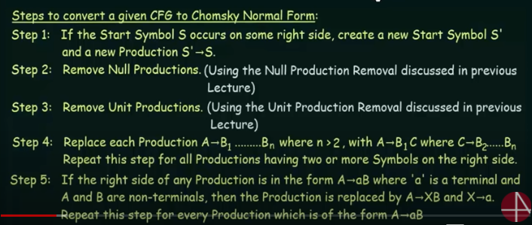
CNF STEPS

Slide 5
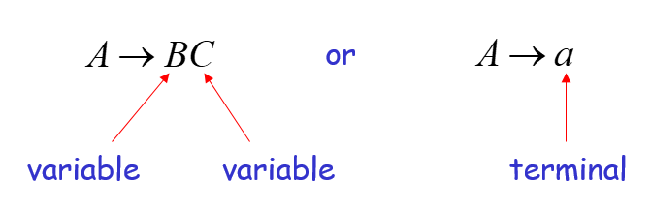
Example
S→ ASA| aB
A→ B| S
B → b |λ
Not in CNF, because it not follow the rules of CNF

Slide 6
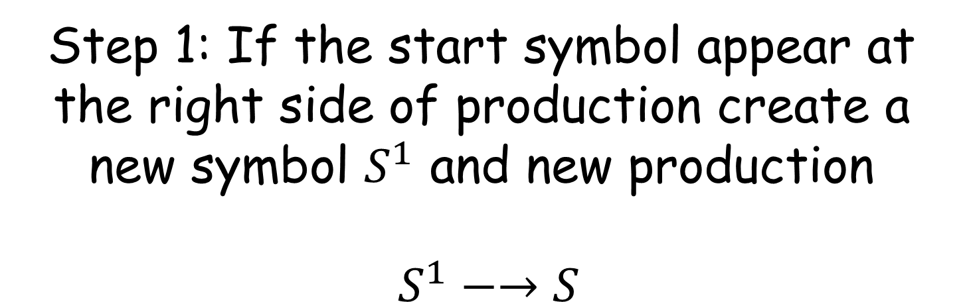
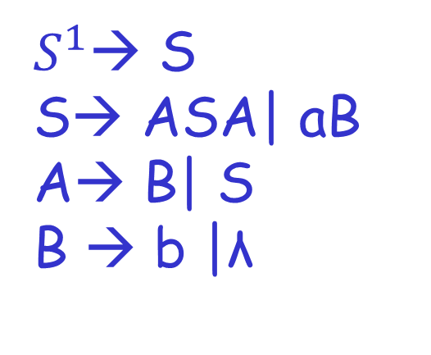
S→ ASA| aB
A→ B| S
B → b |λ

Slide 7

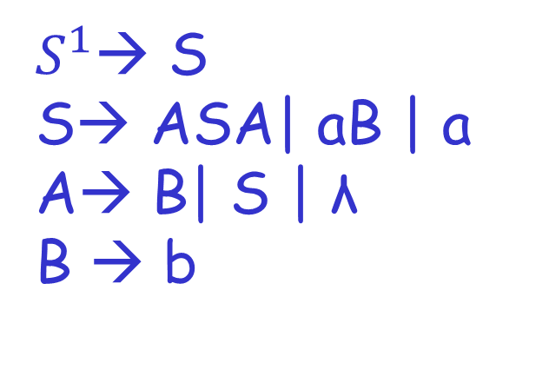
Step # 2 Remove Null Productions
Removing B→ λ

Slide 8

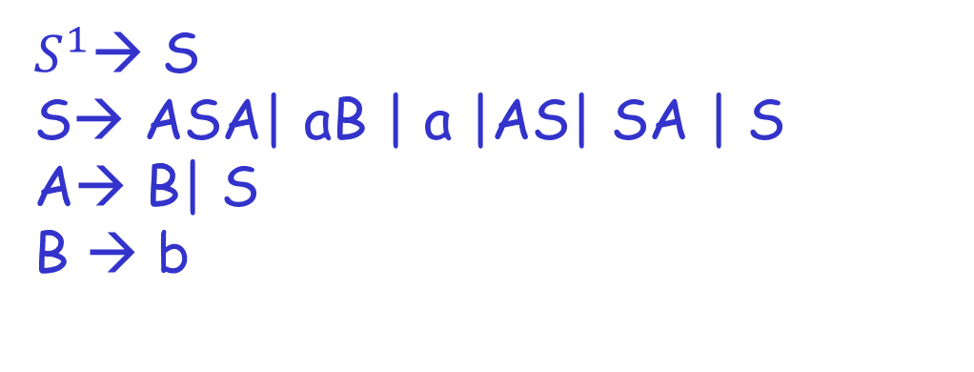
Step # 2 Remove Null Productions
Removing A→ λ

Slide 9
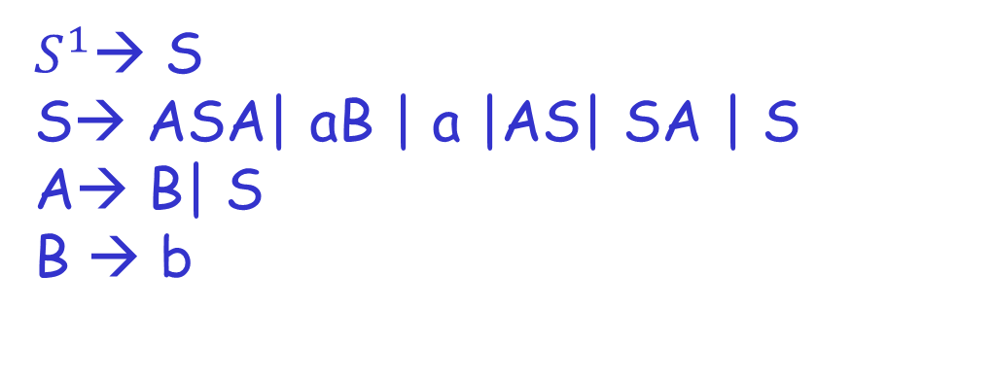
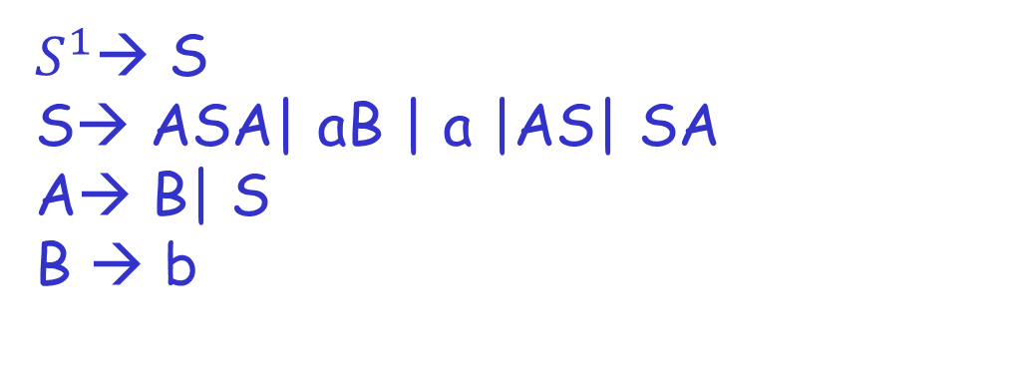
Step # 3 Remove Unit Productions
Remove S → S

Slide 10
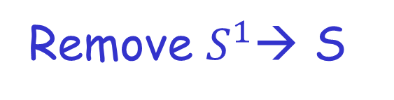
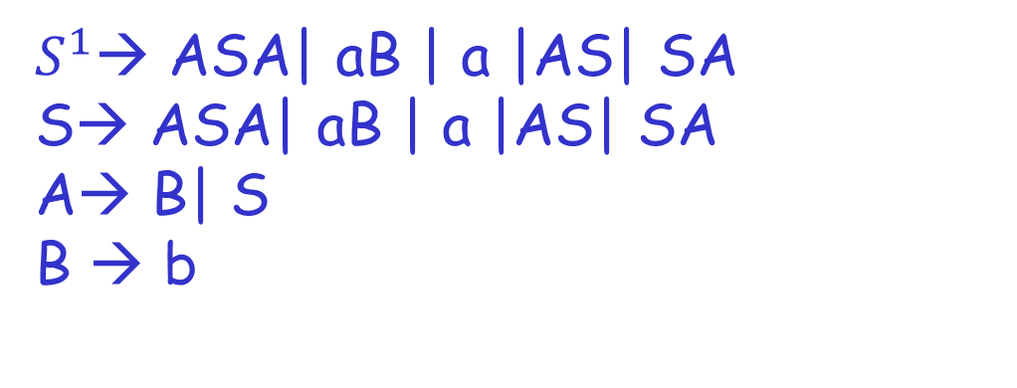
Step # 3 Remove Unit Productions

Slide 11

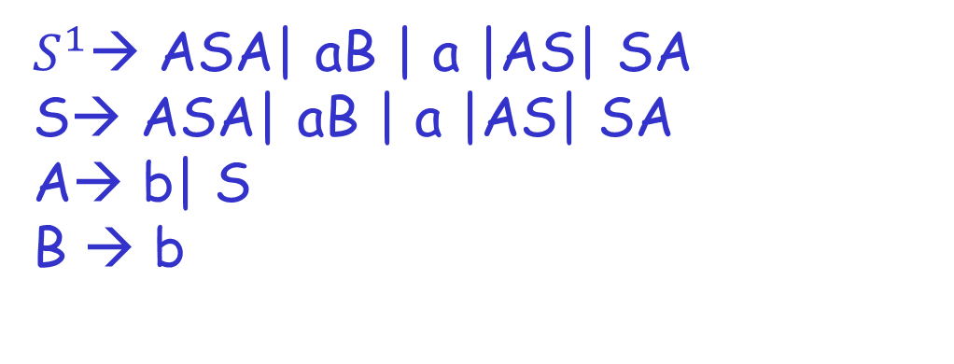
Step # 3 Remove Unit Productions
Remove A→ B

Slide 12

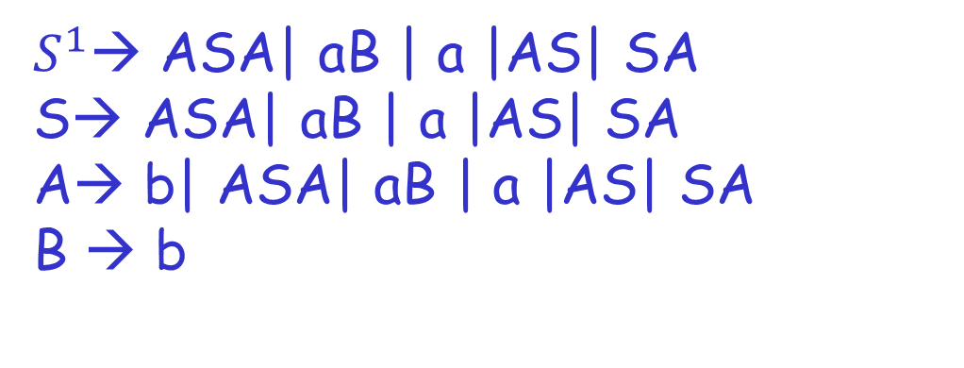
Step # 3 Remove Unit Productions
Remove A→ S

Slide 13
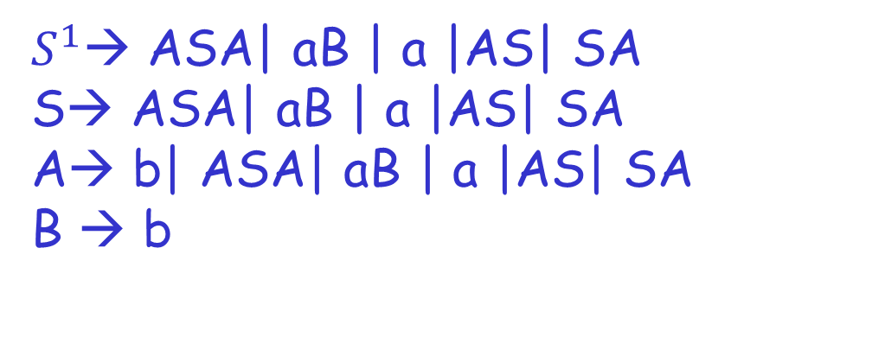

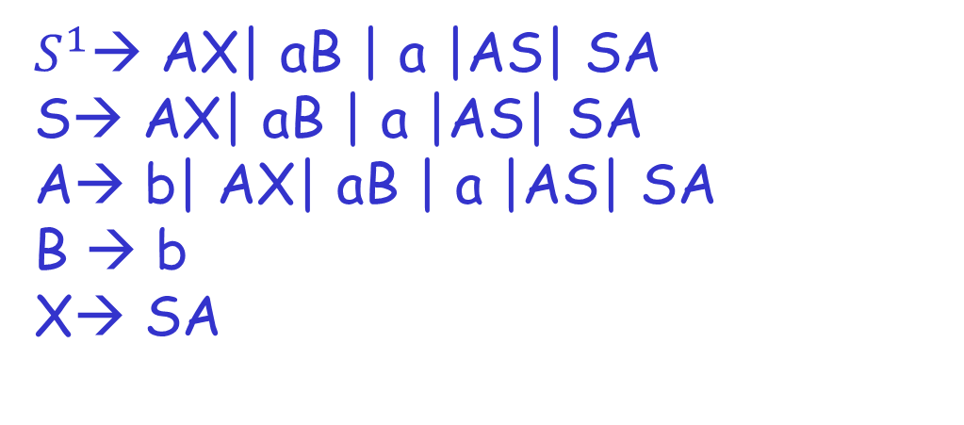
Step # 4 Remove More than two variables on RHS

Slide 14

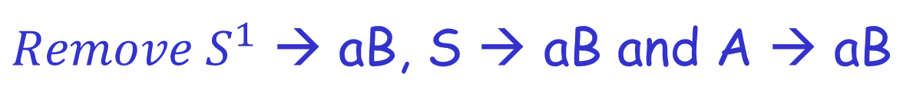
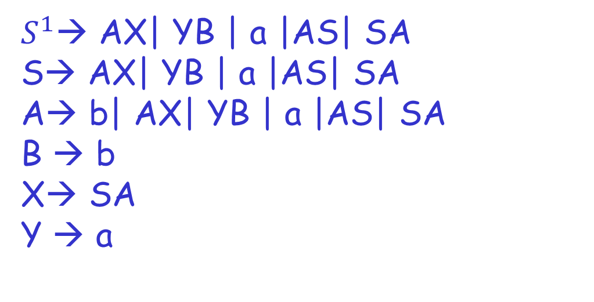
Step # 5

Slide 15

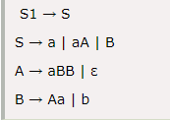
Example # 2
Step 1: We will create a new production
S1 → S, as the start symbol S appears on
the RHS.

Slide 16
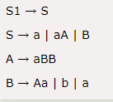
Step 2: As grammar G1 contains A → ε null production, its removal from the grammar yields:

Slide 17
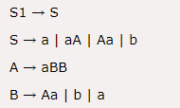
Now, as grammar G1 contains Unit production S → B, its removal yield:

Slide 18
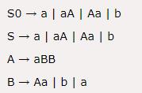
Also remove the unit production S1 → S, its removal from the grammar yields:

Slide 19
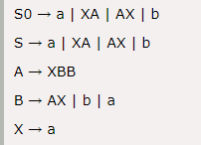
Step 3: In the production rule S0 → aA | Aa, S → aA | Aa, A → aBB and B → Aa, terminal a exists on RHS with non-terminals. So we will replace terminal a with X:

Slide 20
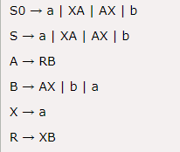
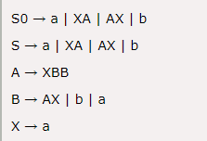
Step 4: In the production rule A → XBB, RHS has more than two symbols, removing it from grammar yield:

Slide 21
X→ ABXY
Step # 1
X → ABC
C → XY
Step # 2
X → AD
D → BC
C →XY

